Slide 1





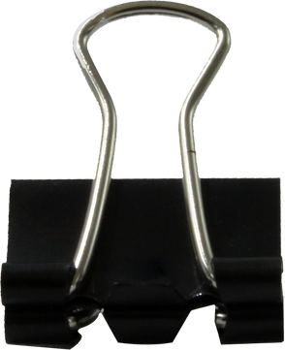











Solutions of equations: Root-finding
MEMBERS OF THE GROUP
Olivia Natsya Yuniar (24083010012)
Zelga Rahma Salsa Aziza (24083010015)
Lila Fifa Ardani (24083010025)
SOLUTIONS OF EQUATIONS: ROOT-FINDING

Slide 2






2.1 Error analysis for iterative methods
Error analysis assesses the speed of the iterative method towards the root of the function. If |pₙ₊₁−p| ≤ C|pₙ−p|ᵅ, then α is the order of convergence; α=1 is linear, α=2 is quadratic, the larger α the faster the convergence.

Slide 3
2.2 Bisection method
The bisection method uses the Intermediate Value Theorem. If f(a)·f(b)<0, the root is in [a,b]. The interval is divided in half, and subintervals with different function signs are selected until the function converges.

Slide 4
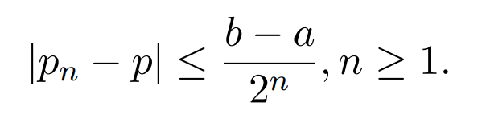
2.2 Bisection method
The error of this method satisfies the formula |pₙ−p| ≤ (b−a)/2ⁿ, meaning the result gets closer to the root with each step. This method has a linear convergence rate and is run with the bisection(f,a,b,eps,N) function until the result is sufficiently accurate or the iteration limit is reached.

Slide 5
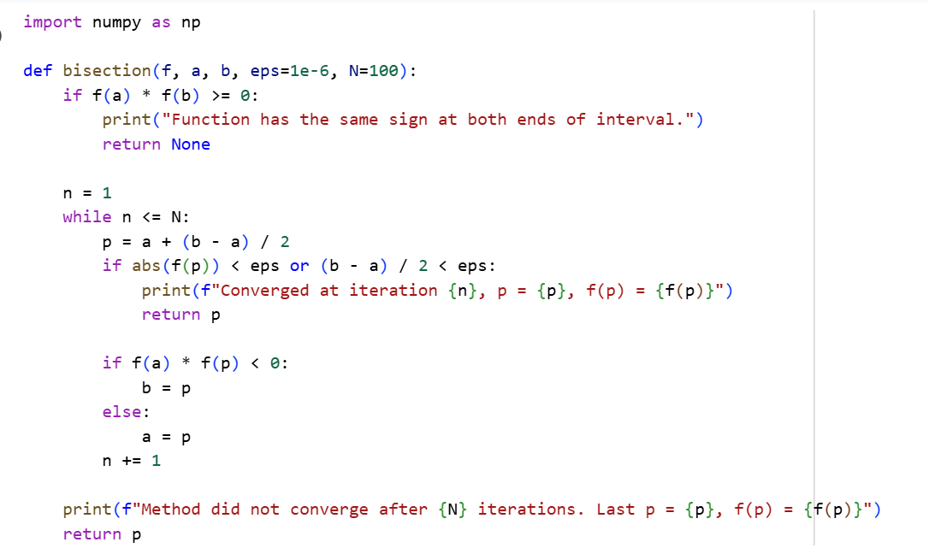
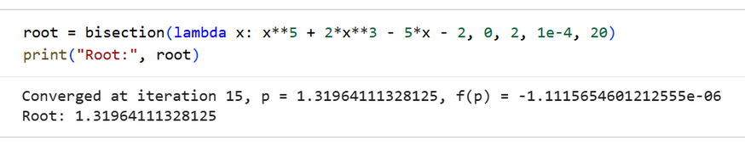
2.2 Bisection method
The image shows Python code implementing the Bisection Method to find a root of a nonlinear equation using interval halving and convergence criteria.

Slide 6
2.3 Newton’s method
Failure of Newton's method: Occurs if f'(Pn) = 0 at the nth iteration, graphically the tangent line parallel to the x-axis does not intersect the x-axis, no new roots can be calculated.

Slide 7
2.3 Newton’s method
Convergence failure: if the initial guess p0 is not close enough to the true root p. And As a result, the iteration can oscillate (back and forth) and not approach the root at all. This figure shows the non-convergence behavior of Newton's Method.

Slide 8
2.3 Newton’s method
Derivative requirements in Newton's method: 1. Newton's method requires the derivative of f'(x) to be known explicitly. 2. Without a clear derivative form, the iteration process cannot be carried out.

Slide 9
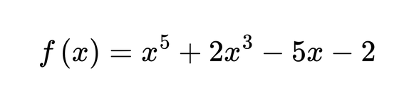
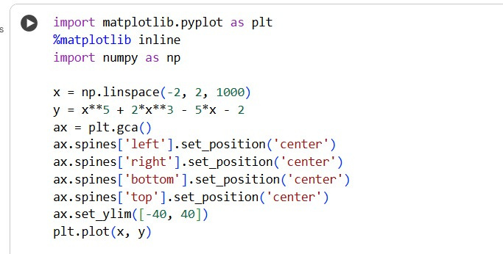
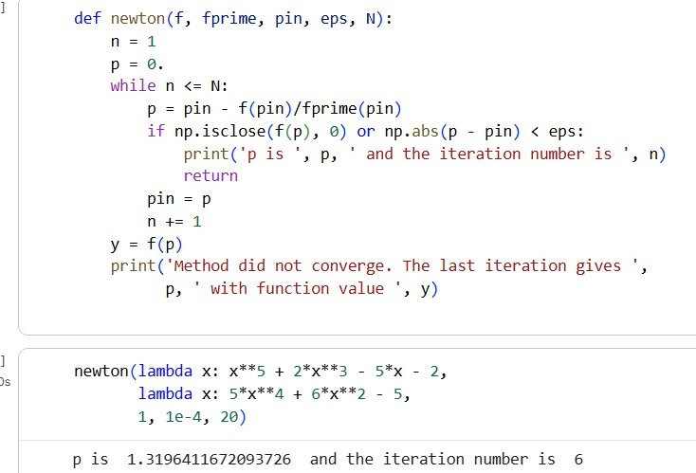
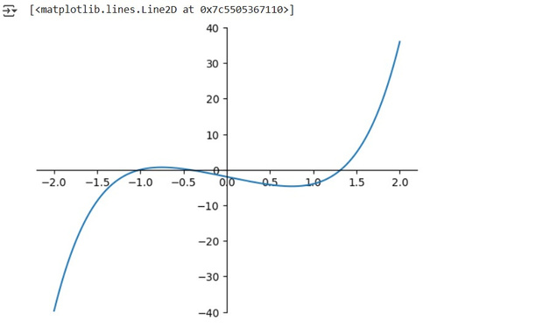
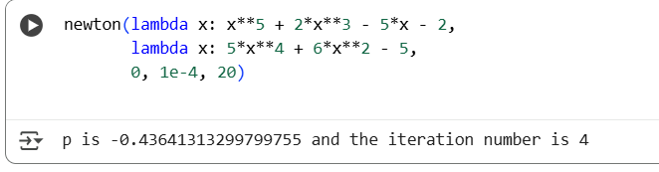
we apply newton's method to find the roots of
this is the function f(x)
this is the first derivative f'(x)
p = 1
this is the function f(x)
this is the first derivative f'(x)
p = 0

Slide 10
2.4 Secant method
Secant Method Concept
The Secant Method is an extension of the Newton-Raphson method that does not require derivatives of functions. The finite difference approach is used to estimate derivatives numerically.

Slide 11
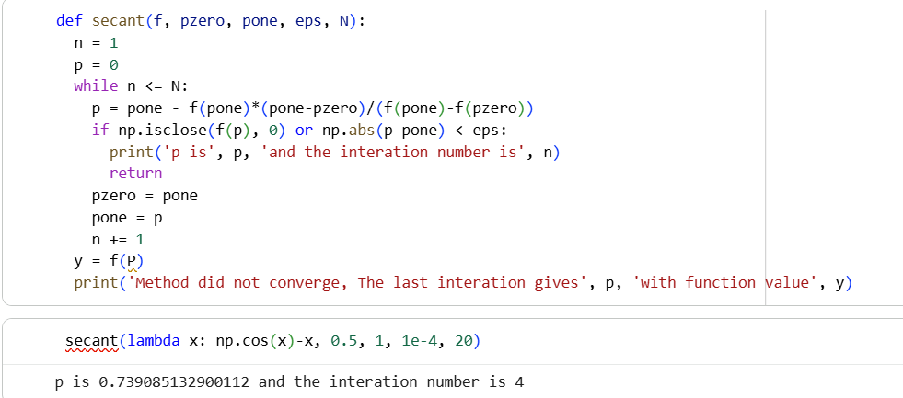
Let’s find the root of f(x) = cosx-x using the secant method, using 0.5 and 1 as the initial guesses

Slide 12
2.4 Secant method
Characteristics and Convergence
This method requires two initial guesses to find the roots of the equation and has a superlinear convergence rate with a convergence ratio of approximately
r ≈ 1.62.

Slide 13
2.5 Muller’s method
Muller's method uses a quadratic parabola approximation through three points to find the roots of a function, forming a quadratic polynomial that estimates the roots more accurately than the Secant method.

Slide 14
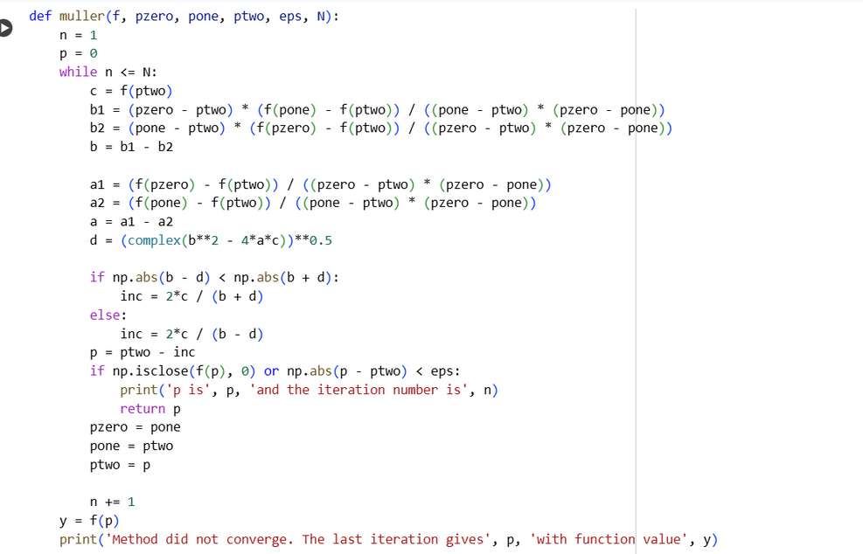
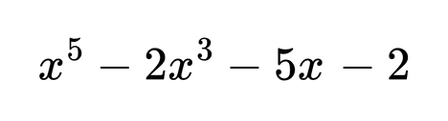
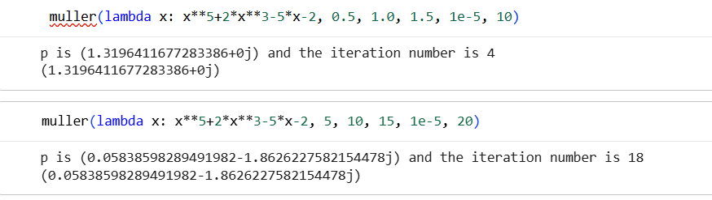
example :
The polynomial
has three real roots, and two complex roots that are conjugates. Let’s find them all, by experimenting with various initial guesses.

Slide 15
2.6 Fixed-point iteration
Fixed-point iteration is a method of finding the value of x that satisfies an equation, by repeating the calculation many times until the result is stable.

Slide 16
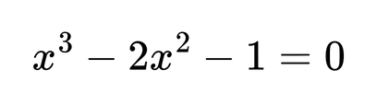
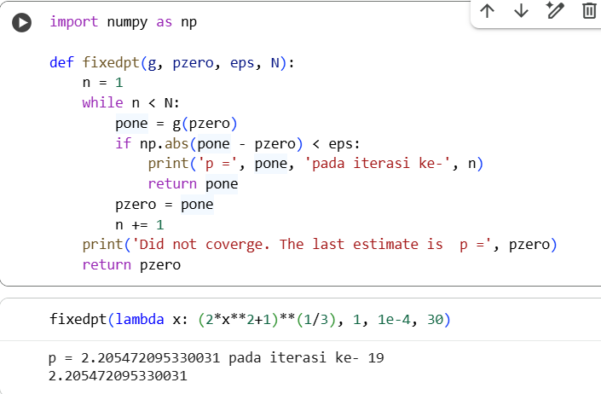

example :
Consider the root-finding problem
on [1,3]

Slide 17
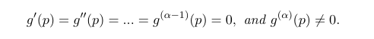
2.7 High-order fixed-point iteration
then the iteration has a convergence order = α.
α = 1 → linear convergence (slow)
α = 2 → quadratic convergence (fast)
α = 3 → cubic convergence (even faster)

Slide 18


CONCLUSION
Root-finding methods differ in their convergence speed. The Bisection method has a linear convergence that is slow but stable. Newton-Raphson and Secant methods converge faster by utilizing derivatives or tangent lines. Meanwhile, the Muller method, with its superlinear convergence, can find roots more quickly and accurately, especially for nonlinear functions. The higher the convergence rate, the more efficient and precise the root-finding process becomes.
SOLUTIONS OF EQUATIONS: ROOT-FINDING

Slide 19











FINISH!!!!!!!
F
inish
SOLUTIONS OF EQUATIONS: ROOT-FINDING

